Slide 1

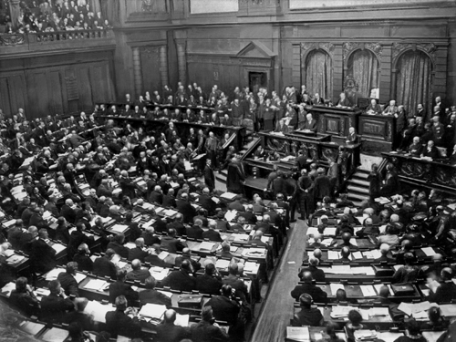
Weimar Republic and Hitler
1.) 1919- Constitution established a Republic in Germany
A) Parliamentary Legislative Branch- Reichstag
B) Independent Executive like U.S.- Chancellor
C) Seemed doomed to failure from beginning- Why?

Slide 2
2.) Reasons for Failure:
Germans feel guilt for war placed on them was unfair
Harsh punishments (reparations) were unfair
Treaty of Versailles
People immediately oppose Weimar Republic
Kaiser and military leaders escaped blame, so they became identified with glories of the fatherland
Germany’s decline was associated with the republic

Slide 3
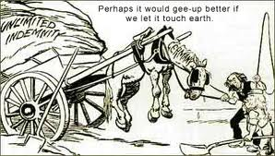

Slide 4
B) Weimar Republic plagued with groups who want to overthrow it- why?
1) German Communists- want a regime like Russia
2) Right wing groups want monarchy or dictatorship
3) Minor rebellions occur like Hitler’s beer hall putsch (1923)

Slide 5
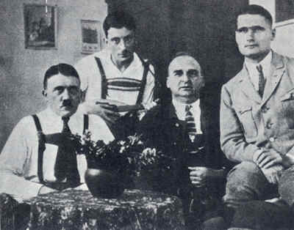

Slide 6
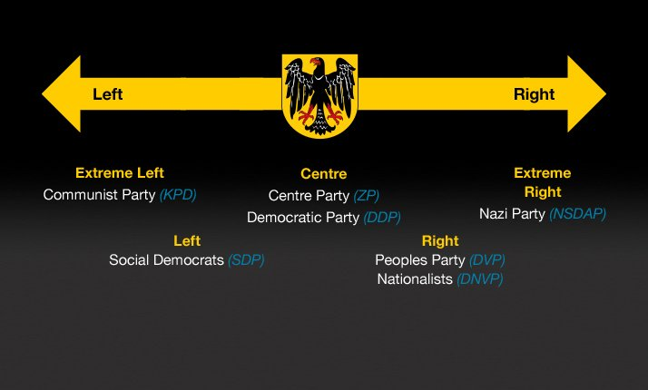
C) Supporters of Republic contribute to downfall- Why?
1) Instead of grouping into a few major parties with wide appeal, they separate into many small parties, so:
2) No single party can win majority in Reichstag

Slide 7
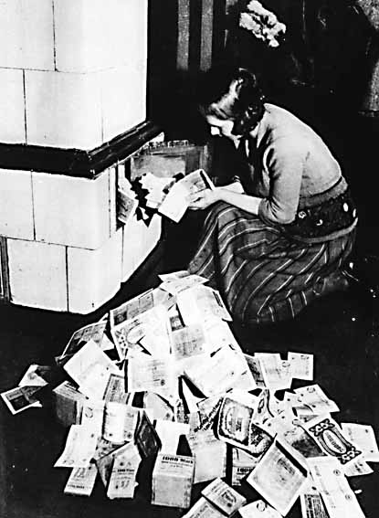
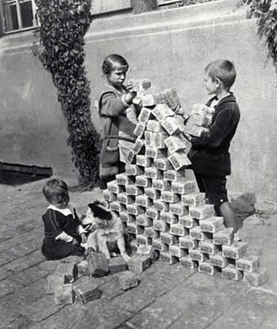
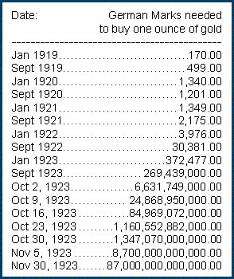
D) Widespread inflation hits in 1923, yet by the middle and end of the 1920s, recovery seems to be coming

Slide 8
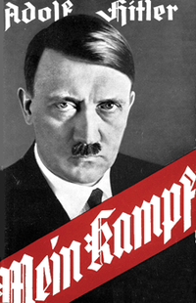
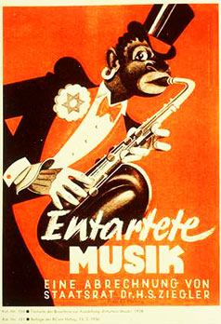
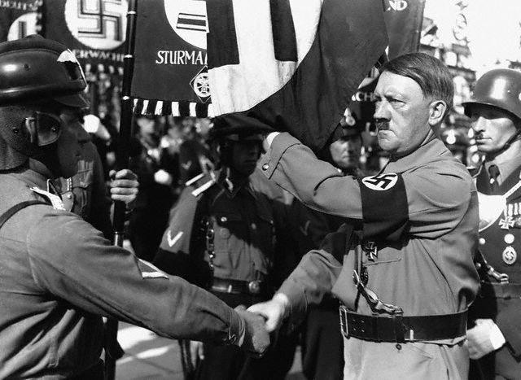
3) Hitler’s Rise
Uses time after putsch and prison term to organize
Raised a small private army of war veterans
Organized local party groups to spread propaganda
Organized a cabinet so he was ready to run the government

Slide 9
4) 1929 Depression- Weimar government was unable to deal with it:
- Hitler’s National Socialist German Worker’s Party (Nazi Party) were a strong political force
5) 1932 Election: Nazis won more seats than any other party
- 288 of 638, so with allies, Nationalist party (52 seats), Nazis have a majority
Hitler is named chancellor of Germany

Slide 10
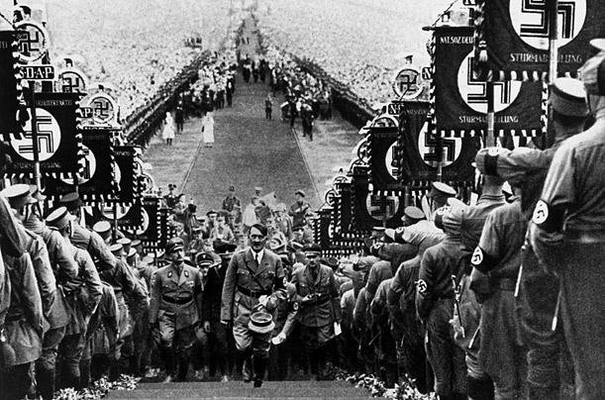
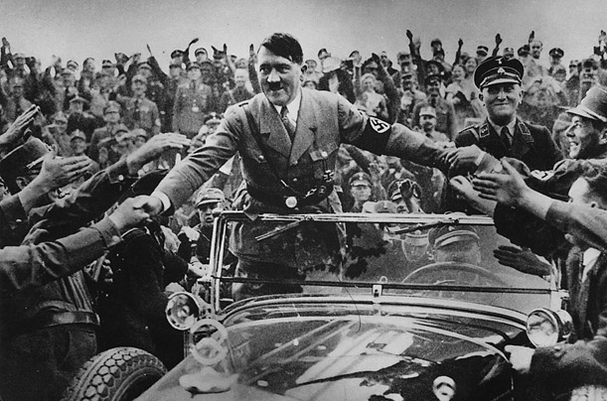
6) 1933- Reichstag passes Enabling Act:
Gave Nazi controlled government dictatorial powers for 4 years
Hitler had arrived, he adjourned Reichstag
it never met again

Slide 11
